Slide 1

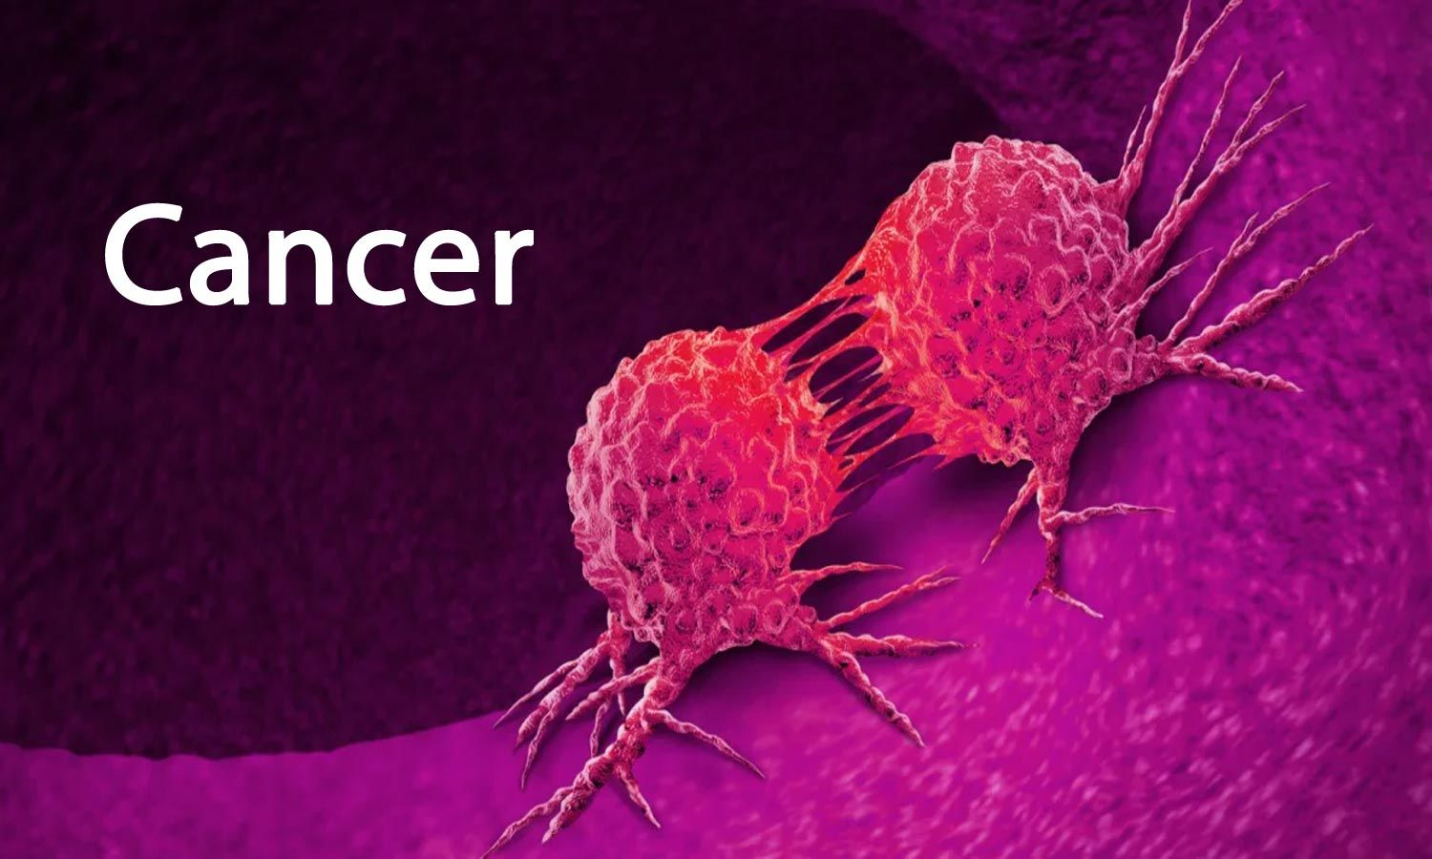
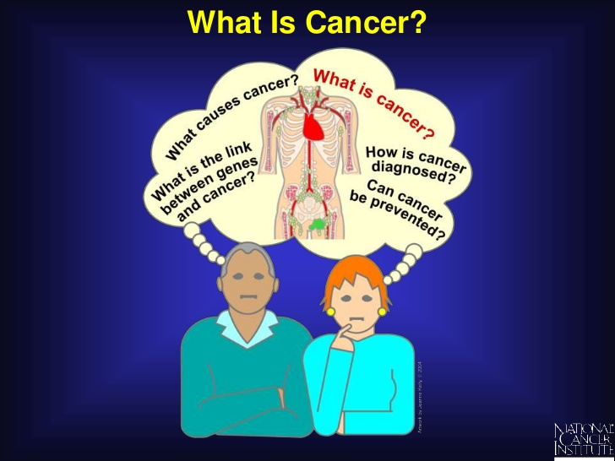
V
Topic: Cancer As a Global Concerning Health Issue?
V
Into the Void of
Mental Health Issues
Group-3
So, what is Cancer?
What do we know about CANCER?
Nusrat Jahan
ID:1911657042
Normal Cells divide as the body need them. But in cancer cells, it grows rapidly and expands locally by invasion and metastasis

Slide 2
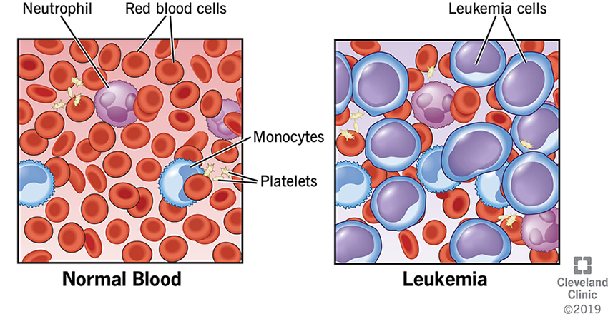
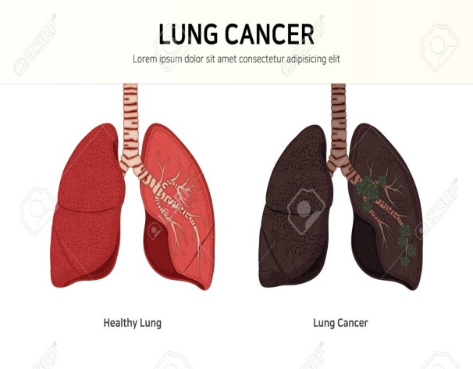
Types of Cancer
There are over 100 types of Cancer.But there are 5 types of main cancers.
Carcinomas,Sarcomas,Leukemia,Lymphoma,Melanoma.
How many types of cancer are there?
Most Dangerous Cancers:
Lung Cancer
Breast Cancer
Colon Cancer
Ovarian Cancer
Prostate Cancer
Pancreatic

Slide 3

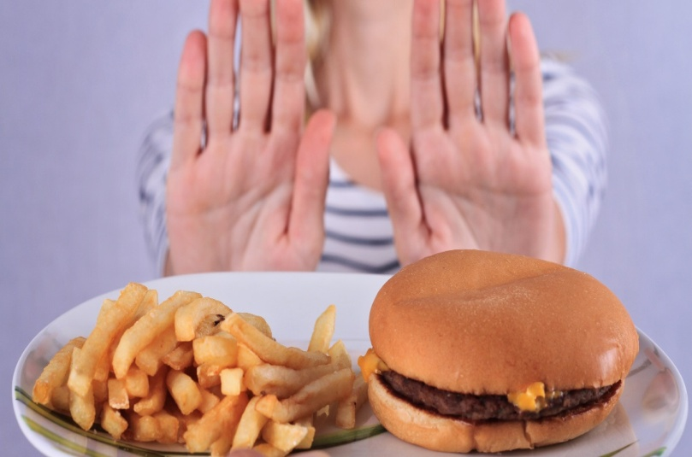
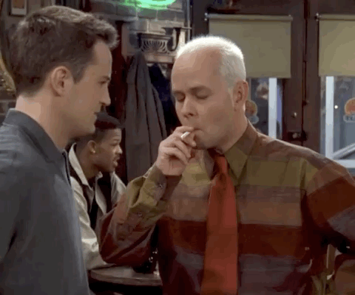
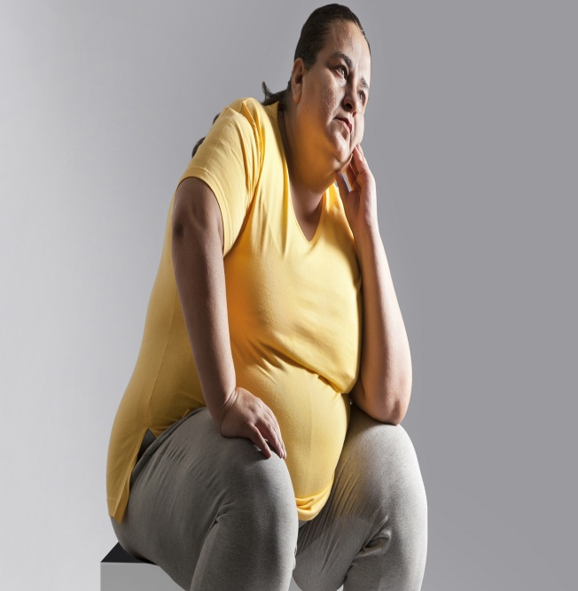
Causes of Cancer
Leading Cause of Cancer is “SMOKING”.19.0%
If some is obese or overweight.7.8%
Drinking Alcohol.5.6%
C
A
U
S
E
S
V
I
UV Radiation.4.7%
Physical inactivity.2.9%
Poor diet or
eating junk
food like
Cheese,Burger,
pizza.1.9%
V
I
Physical
inactivity.2.9%
0
0
0
0
0
0

Slide 4
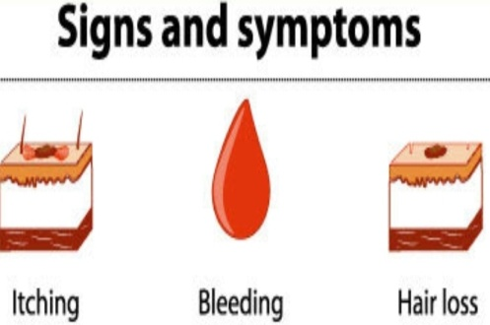
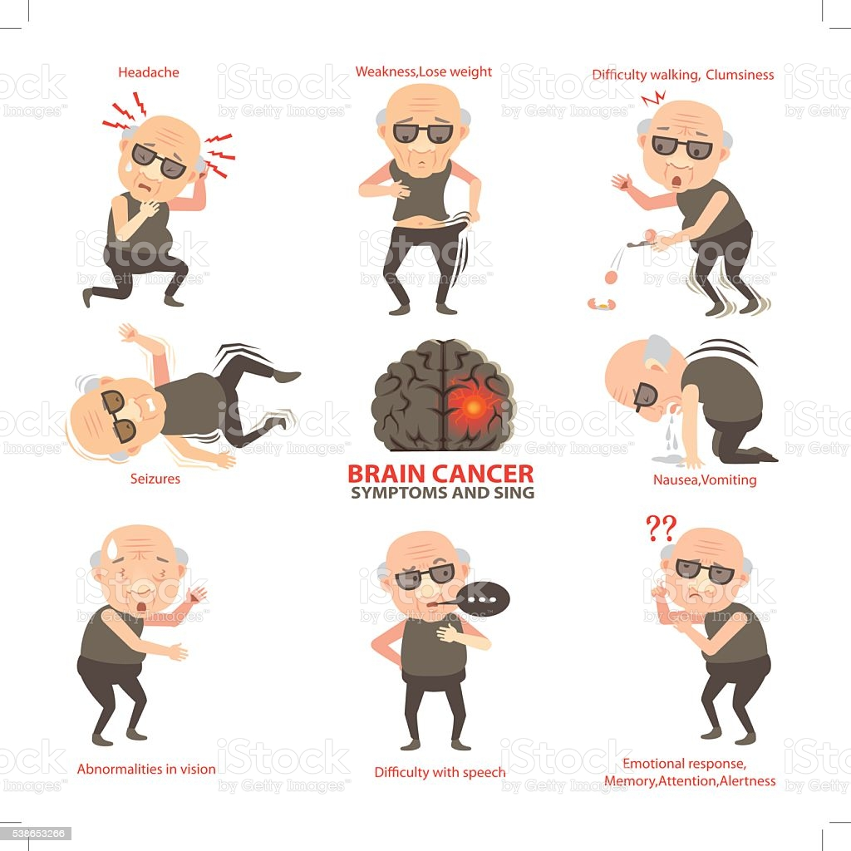
Headache
Weakness Weights
Difficulty for being productive,walking
Signs
V
I
Difficulty with speech
&
Symptoms
Emotional response,
Memory loss, alertness
V
I
Bleeding or bruising
Nausea,Vomiting

Slide 5


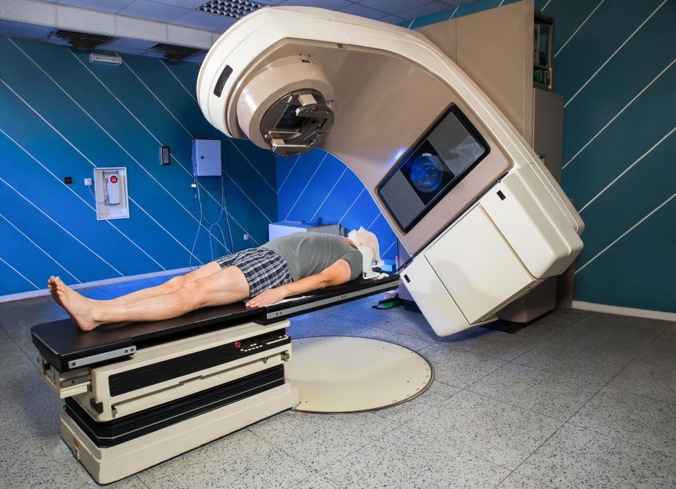
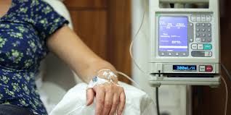
Treatment & Prevention
0
Maintaining a healthy diet and physically active lifestyle
0
0
0
Get Vaccinated to protect from STI,STD
0
0
0
Medications and stop smoking Tobacco
0
0
0
Treatment:
Surgery
Chemotherapy
Radiation
0
0

